Slide 1
Google Maps API and
Python Best Practices
June 5, 2023

Slide 2
What group developed the GPS?

Slide 3
Agenda
What is an API?
What is the Google Maps API?
How do I set it up?
How can I get coordinates of given addresses?
How can I get addresses of given coordinates?
How do I incorporate the results in Python or Power BI?
What else can the Google Maps API do?
Q&A

Slide 4
What is an API?

Slide 5
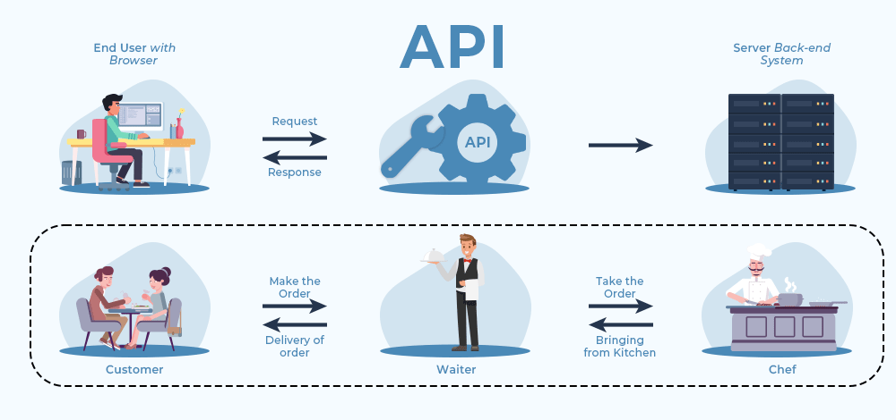
Photo from GeekForGeeks

Slide 6






Slide 7
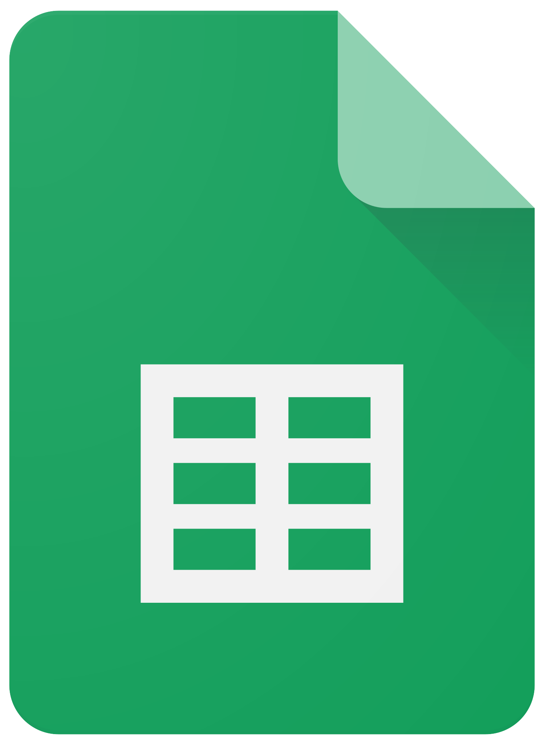
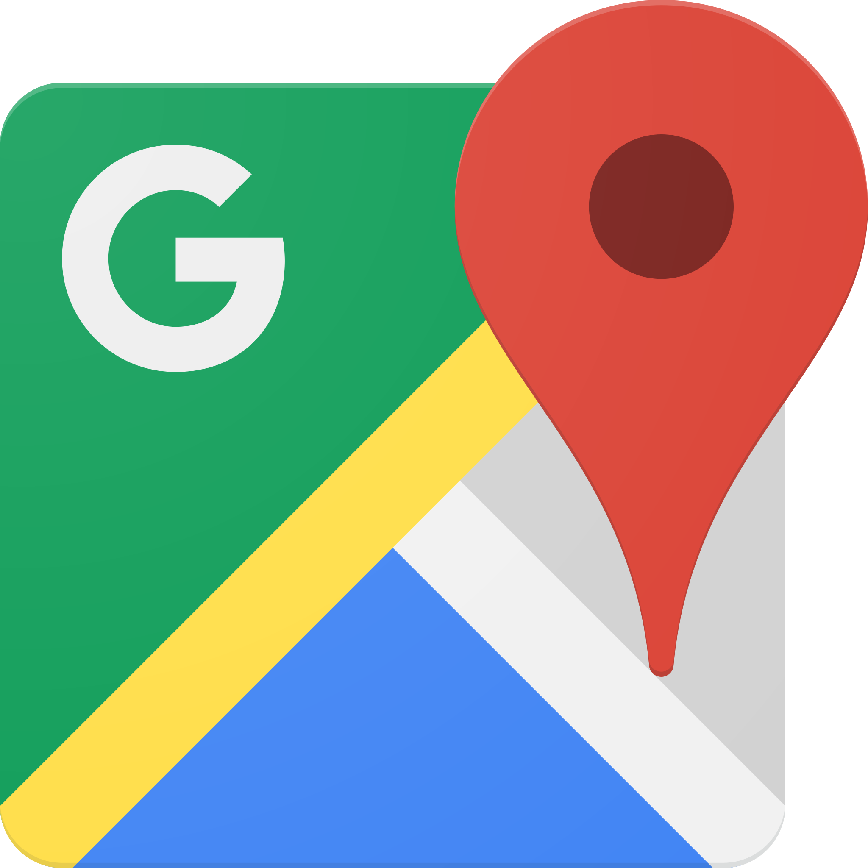


Slide 8
What is the Google Maps API?

Slide 9
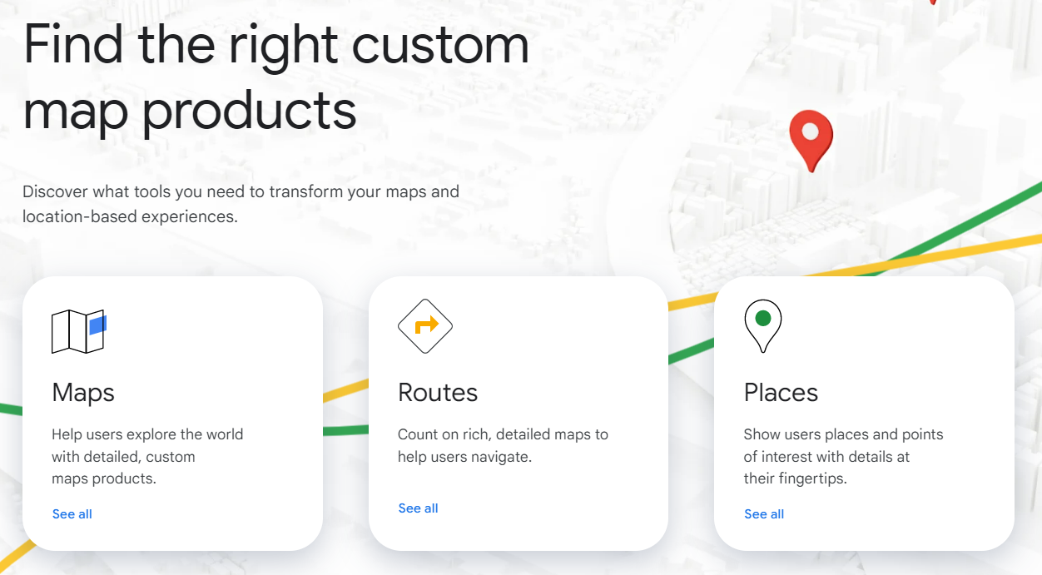

Slide 10
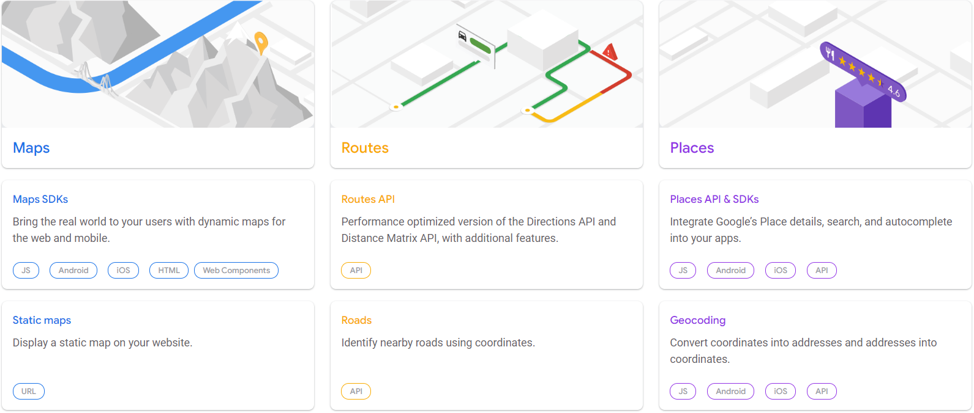

Slide 11
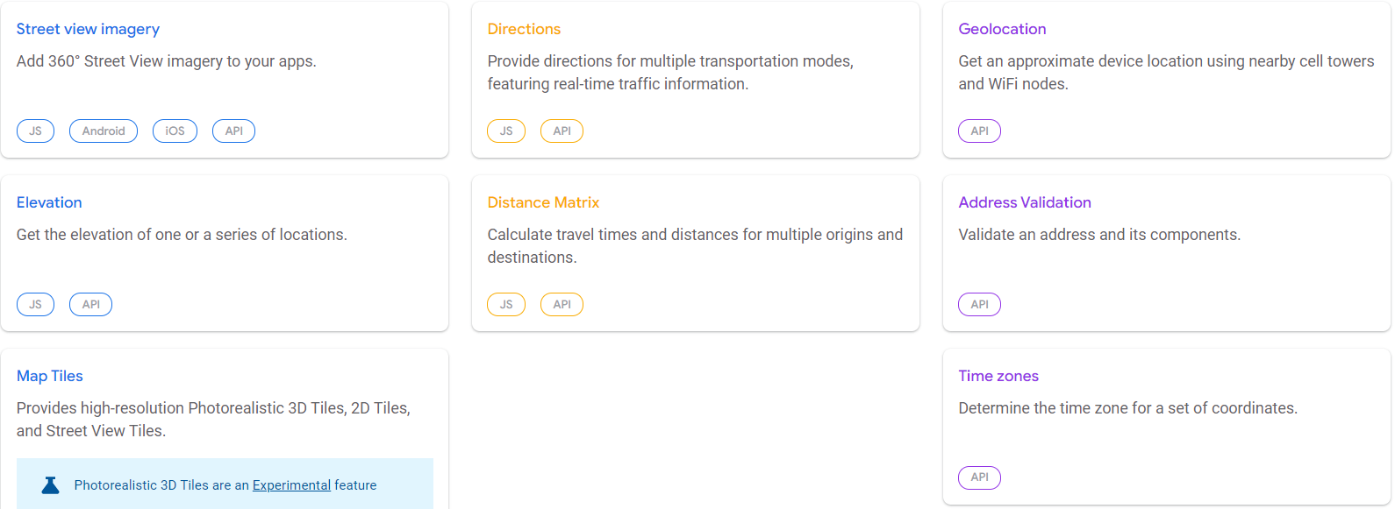

Slide 12
How do I set up the Google Maps API?

Slide 13
How do I set up the Google Maps API?
Make a Google Cloud Platform account (cloud.google.com)*
Enable the Maps API
Copy the API key (do not share)
Install Python or Anaconda
Create a virtual environment
Install the required libraries
Create an environment variable
*Unfortunately, you need to input your credit card details to use the Maps API ☹

Slide 14
How can I get coordinates of given addresses? (Geocoding)

Slide 15
How can I get the addresses of given coordinates? (Reverse Geocoding)

